Slide 1

By:
Nicholas Vallarelli, Ojonugwa Oji, Verena Barth,
Payal Narkhede, and Vishnu Mullick

Slide 2
COBOL History
COBOL means ‘Common Business Oriented Language’
It was formed in 1959
One of the earliest high level programming languages
CODASYL: the Conference/Committee on Data Systems Languages - used to guide the development of programming languages that could be used on many computers
Was partly based on previous programming language design by Grace Hopper who created one of the first English-like data processing language
Multi Platform Computer
A scalable language
Still used today

Slide 3
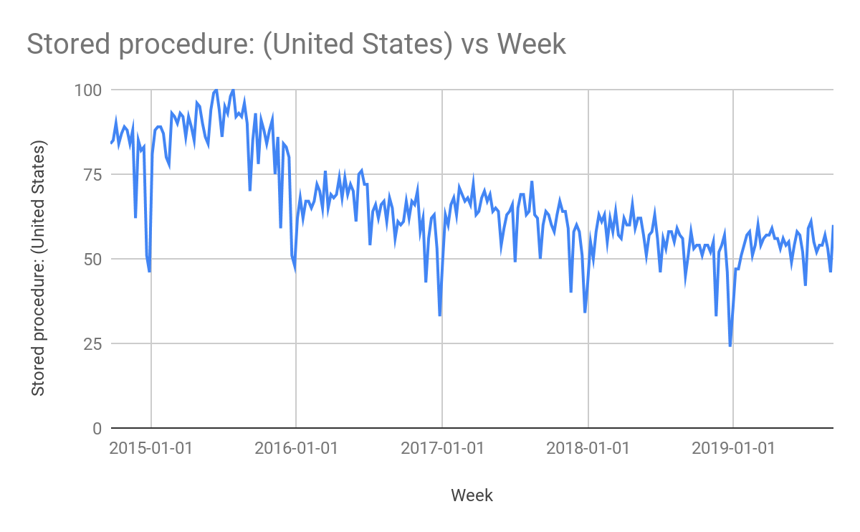
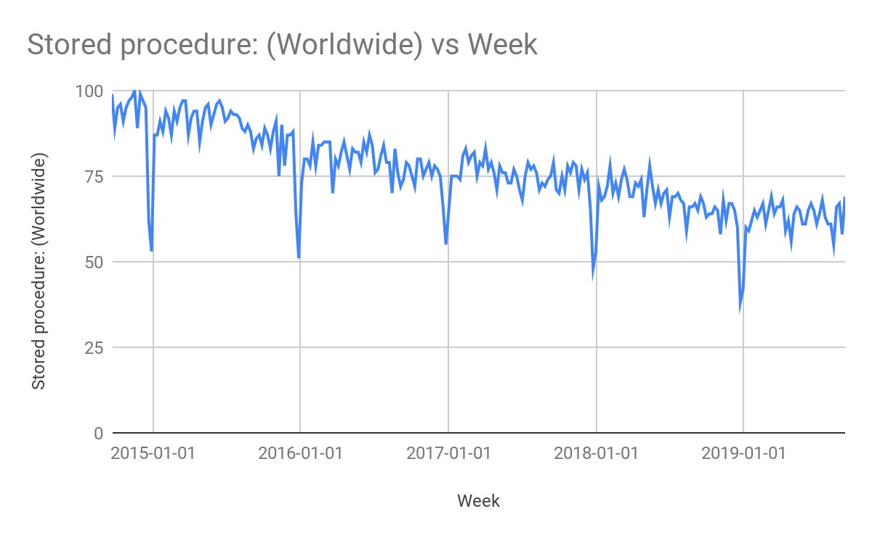
Google Trends: COBOL
USA
GLOBAL
City: (40)
Eden Prairie
NY number (20th)
Least is Philly
World: (70)
China
US (18th)
Brazil

Slide 4
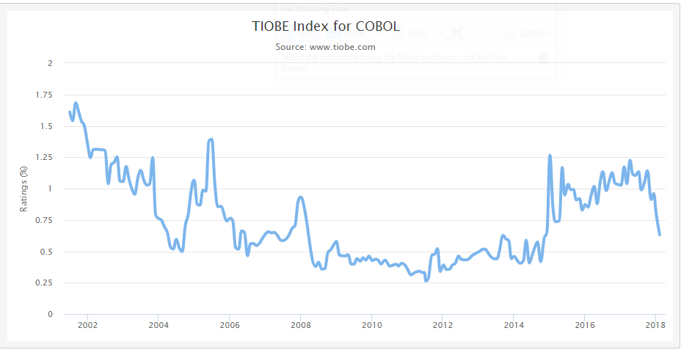
TIOBE: COBOL
35

Slide 5
Range of use
Business, finance, administrative systems, banking
Mainframe computers
→ High performance, accuracy
70 - 80%
of all business transactions
95% ATM transactions
daily
~ 220 Bn
lines of code

Slide 6
Features of COBOL
Standard Language
Can be compiled on machines
No pointers
No user defined types or functions
Business Oriented
Can easily handle large amounts of data
Advanced file handling capabilities
Robust Language
Can be debugged, tested, and compiled on almost every platform
Structured Language
Language is very easy to read
Can be debugged reliably

Slide 7
Features Exclusive to COBOL
Long Lasting
Has adapted to new changes and continues to be used across all platforms
Receives new updates every year
Work Friendly
Works excellently in a business setting
If maintained, COBOL projects can last decades
Reliable with high-budget projects
Versatility
Continues to serve as the primary foundation for many computer mainframes
Hundreds of companies still use COBOL to this day

Slide 8
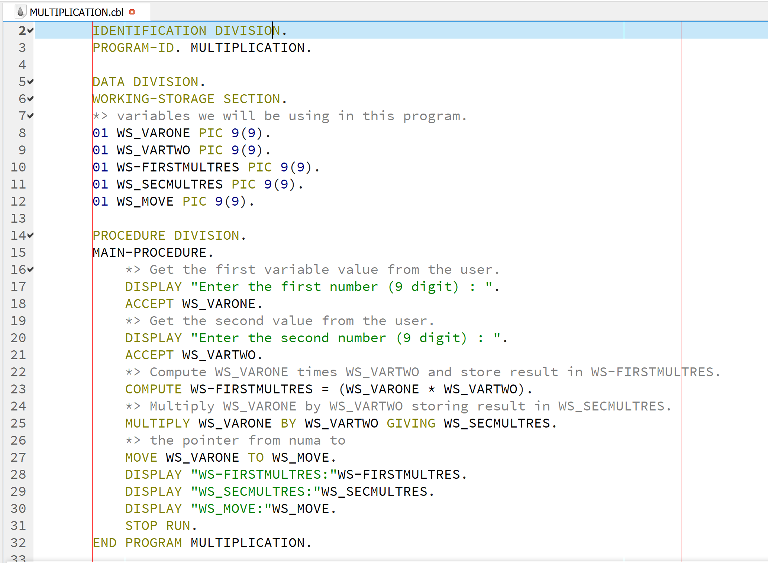
COBOL Code
OpenCOBOL IDE
Multiplication Program
Source code is divided in following divisions:
Identification Division
Environment Division
Data Division
Procedure Division

Slide 9
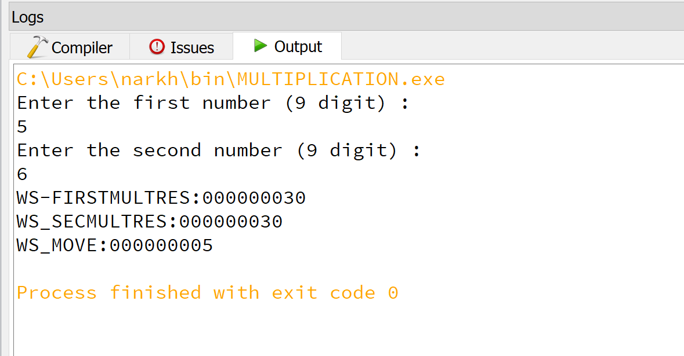
COBOL Code Result

Slide 10

COBOL Code Video
Click center of black box to play video

Slide 11
Conclusion
COBOL is very interesting, easy to learn, and a widely used language for business and financial applications which was designed to accommodate complex data sets while efficiently using computer resources.

Slide 12
References
https://www.tutorialspoint.com/cobol/cobol_overview.htm
https://medium.com/@yvanscher/7-cobol-examples-with-explanations-ae1784b4d576
https://medium.com/@bellmar/is-cobol-holding-you-hostage-with-math-5498c0eb428b
https://blog.hackerrank.com/the-inevitable-return-of-cobol/
https://www.backbase.com/2018/04/19/cobol-and-the-big-tin-bank/
https://cacm.acm.org/news/231386-do-you-know-cobol-if-so-there-might-be-a-job-for-you/fulltext
https://ieeexplore.ieee.org/document/841602
https://www.csee.umbc.edu/courses/graduate/631/Fall2002/COBOL.pdf
https://www.cleverism.com/skills-and-tools/cobol/
https://developer.ibm.com/mainframe/2019/02/26/cobol-and-the-enterprise-business-programming-paradigm/
https://www.techopedia.com/definition/25326/legacy-code
Download IDE & link to code examples
https://launchpad.net/cobcide/+download https://drive.google.com/open?id=1O2QDN1dgYG9rGjFnMeWoQCgdJ7ShB9yq

